Slide 1

CS 361A
(Advanced Data Structures and Algorithms)
Lecture 20 (Dec 7, 2005)
Data Mining: Association Rules
Rajeev Motwani
(partially based on notes by Jeff Ullman)

Slide 2
Association Rules Overview
Market Baskets & Association Rules
Frequent item-sets
A-priori algorithm
Hash-based improvements
One- or two-pass approximations
High-correlation mining

Slide 3
Association Rules
Two Traditions
  DM is science of approximating joint distributions
    Representation of process generating data
    Predict P[E] for interesting events E
  DM is technology for fast counting
    Can compute certain summaries quickly
    Lets try to use them
Association Rules
  Captures interesting pieces of joint distribution
  Exploits fast counting technology

Slide 4

Market-Basket Model
Large Sets
  Items A = {A₁, A₂, …, A_{m}}
    e.g., products sold in supermarket
  Baskets B = {B₁, B₂, …, B_{n}}
    small subsets of items in A
    e.g., items bought by customer in one transaction
Support – sup(X) = number of baskets with itemset X
Frequent Itemset Problem
  Given – support threshold s
  Frequent Itemsets –
  Find – all frequent itemsets

Slide 5
Example
Items A = {milk, coke, pepsi, beer, juice}.
Baskets
  B₁ = {m, c, b} B₂ = {m, p, j}
  B₃ = {m, b} B₄ = {c, j}
  B₅ = {m, p, b} B₆ = {m, c, b, j}
  B₇ = {c, b, j} B₈ = {b, c}
Support threshold s=3
Frequent itemsets
  {m}, {c}, {b}, {j}, {m, b}, {c, b}, {j, c}

Slide 6
Application 1 (Retail Stores)
Real market baskets
  chain stores keep TBs of customer purchase info
  Value?
    how typical customers navigate stores
    positioning tempting items
    suggests “tie-in tricks” – e.g., hamburger sale while raising ketchup price
    …
High support needed, or no $$’s

Slide 7
Application 2 (Information Retrieval)
Scenario 1
  baskets = documents
  items = words in documents
  frequent word-groups = linked concepts.
Scenario 2
  items = sentences
  baskets = documents containing sentences
  frequent sentence-groups = possible plagiarism

Slide 8
Application 3 (Web Search)
Scenario 1
  baskets = web pages
  items = outgoing links
  pages with similar references → about same topic
Scenario 2
  baskets = web pages
  items = incoming links
  pages with similar in-links → mirrors, or same topic

Slide 9
Scale of Problem
WalMart
  sells m=100,000 items
  tracks n=1,000,000,000 baskets
Web
  several billion pages
  one new “word” per page
Assumptions
  m small enough for small amount of memory per item
  m too large for memory per pair or k-set of items
  n too large for memory per basket
  Very sparse data – rare for item to be in basket

Slide 10
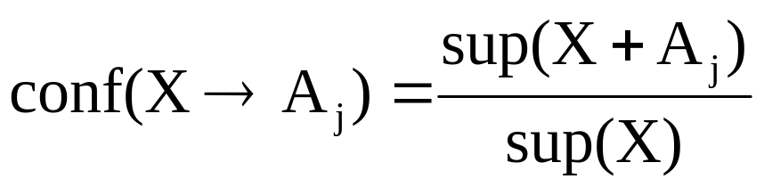
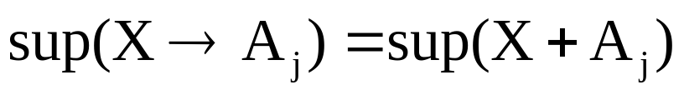
Association Rules
If-then rules about basket contents
  {A₁, A₂,…, A_{k}} → A_{j}
  if basket has X={A₁,…,A_{k}}, then likely to have A_{j}
Confidence – probability of A_{j} given A₁,…,A_{k}
Support (of rule)

Slide 11
Example
  B1 = {m, c, b} B2 = {m, p, j}
  B3 = {m, b} B4 = {c, j}
  B5 = {m, p, b} B6 = {m, c, b, j}
  B7 = {c, b, j} B8 = {b, c}
Association Rule
  {m, b} → c
  Support = 2
  Confidence = 2/4 = 50%

Slide 12


Finding Association Rules
Goal – find all association rules such that
  support
  confidence
Reduction to Frequent Itemsets Problems
  Find all frequent itemsets X
  Given X={A₁, …,A_{k}}, generate all rules X-A_{j} → A_{j}
  Confidence = sup(X)/sup(X-A_{j})
  Support = sup(X)
Observe X-A_{j} also frequent → support known

Slide 13
Computation Model
Data Storage
  Flat Files, rather than database system
  Stored on disk, basket-by-basket
Cost Measure – number of passes
  Count disk I/O only
  Given data size, avoid random seeks and do linear-scans
Main-Memory Bottleneck
  Algorithms maintain count-tables in memory
  Limitation on number of counters
  Disk-swapping count-tables is disaster

Slide 14
Finding Frequent Pairs
Frequent 2-Sets
  hard case already
  focus for now, later extend to k-sets
Naïve Algorithm
  Counters – all m(m–1)/2 item pairs
  Single pass – scanning all baskets
  Basket of size b – increments b(b–1)/2 counters
Failure?
  if memory < m(m–1)/2
  even for m=100,000

Slide 15

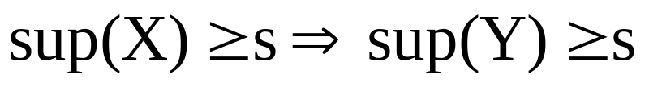
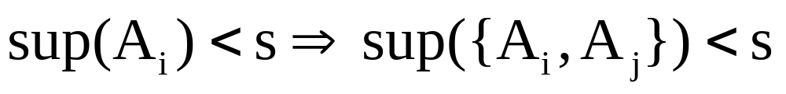
Montonicity Property
Underlies all known algorithms
Monotonicity Property
  Given itemsets
  Then
Contrapositive (for 2-sets)

Slide 16
A-Priori Algorithm
A-Priori – 2-pass approach in limited memory
Pass 1
  m counters (candidate items in A)
  Linear scan of baskets b
  Increment counters for each item in b
Mark as frequent, f items of count at least s
Pass 2
  f(f-1)/2 counters (candidate pairs of frequent items)
  Linear scan of baskets b
  Increment counters for each pair of frequent items in b
Failure – if memory < m + f(f–1)/2

Slide 17
Memory Usage – A-Priori
Candidate Items
Frequent Items
M
E
M
O
R
Y
M
E
M
O
R
Y
Candidate
Pairs
Pass 1
Pass 2

Slide 18
PCY Idea
Improvement upon A-Priori
Observe – during Pass 1, memory mostly idle
Idea
  Use idle memory for hash-table H
  Pass 1 – hash pairs from b into H
  Increment counter at hash location
  At end – bitmap of high-frequency hash locations
  Pass 2 – bitmap extra condition for candidate pairs

Slide 19
Memory Usage – PCY
Candidate Items
Frequent Items
M
E
M
O
R
Y
M
E
M
O
R
Y
Bitmap
Candidate
Pairs
Hash Table
Pass 1
Pass 2

Slide 20
PCY Algorithm
Pass 1
  m counters and hash-table T
  Linear scan of baskets b
  Increment counters for each item in b
  Increment hash-table counter for each item-pair in b
Mark as frequent, f items of count at least s
Summarize T as bitmap (count > s → bit = 1)
Pass 2
  Counter only for F qualified pairs (X_{i},X_{j}):
    both are frequent
    pair hashes to frequent bucket (bit=1)
  Linear scan of baskets b
  Increment counters for candidate qualified pairs of items in b

Slide 21
Multistage PCY Algorithm
Problem – False positives from hashing
New Idea
  Multiple rounds of hashing
  After Pass 1, get list of qualified pairs
  In Pass 2, hash only qualified pairs
  Fewer pairs hash to buckets → less false positives
  (buckets with count >s, yet no pair of count >s)
  In Pass 3, less likely to qualify infrequent pairs
Repetition – reduce memory, but more passes
Failure – memory < O(f+F)

Slide 22
Memory Usage – Multistage PCY
Candidate Items
Frequent Items
Frequent Items
Bitmap
Bitmap 1
Bitmap 2
Hash Table 1
Hash Table 2
Candidate
Pairs
Pass 1
Pass 2

Slide 23
Finding Larger Itemsets
Goal – extend to frequent k-sets, k > 2
Monotonicity
  itemset X is frequent only if X – {X_{j}} is frequent for all X_{j}
Idea
  Stage k – finds all frequent k-sets
  Stage 1 – gets all frequent items
  Stage k – maintain counters for all candidate k-sets
  Candidates – k-sets whose (k–1)-subsets are all frequent
  Total cost: number of passes = max size of frequent itemset
Observe – Enhancements such as PCY all apply

Slide 24
Approximation Techniques
Goal
  find all frequent k-sets
  reduce to 2 passes
  must lose something → accuracy
Approaches
  Sampling algorithm
  SON (Savasere, Omiecinski, Navathe) Algorithm
  Toivonen Algorithm

Slide 25
Sampling Algorithm
Pass 1 – load random sample of baskets in memory
Run A-Priori (or enhancement)
  Scale-down support threshold (e.g., if 1% sample, use s/100 as support threshold)
  Compute all frequent k-sets in memory from sample
  Need to leave enough space for counters
Pass 2
  Keep counters only for frequent k-sets of random sample
  Get exact counts for candidates to validate
Error?
  No false positives (Pass 2)
  False negatives (X frequent, but not in sample)

Slide 26
SON Algorithm
Pass 1 – Batch Processing
  Scan data on disk
  Repeatedly fill memory with new batch of data
  Run sampling algorithm on each batch
  Generate candidate frequent itemsets
Candidate Itemsets – if frequent in some batch
Pass 2 – Validate candidate itemsets
Monotonicity Property
  Itemset X is frequent overall → frequent in at least one batch

Slide 27
Toivonen’s Algorithm
Lower Threshold in Sampling Algorithm
  Example – if sampling 1%, use 0.008s as support threshold
  Goal – overkill to avoid any false negatives
Negative Border
  Itemset X infrequent in sample, but all subsets are frequent
  Example: AB, BC, AC frequent, but ABC infrequent
Pass 2
  Count candidates and negative border
  Negative border itemsets all infrequent → candidates are exactly the frequent itemsets
  Otherwise? – start over!
Achievement? – reduced failure probability, while keeping candidate-count low enough for memory

Slide 28
Low-Support, High-Correlation
Goal – Find highly correlated pairs, even if rare
Marketing requires hi-support, for dollar value
But mining generating process often based on hi-correlation, rather than hi-support
  Example: Few customers buy Ketel Vodka, but of those who do, 90% buy Beluga Caviar
  Applications – plagiarism, collaborative filtering, clustering
Observe
  Enumerate rules of high confidence
  Ignore support completely
  A-Priori technique inapplicable

Slide 29
Matrix Representation
Sparse, Boolean Matrix M
  Column c = Item X_{c}; Row r = Basket B_{r}
  M(r,c) = 1 iff item c in basket r
Example
  m c p b j
  B₁={m,c,b} 1 1 0 1 0
  B₂={m,p,b} 1 0 1 1 0
  B₃={m,b} 1 0 0 1 0
  B₄={c,j} 0 1 0 0 1
  B₅={m,p,j} 1 0 1 0 1
  B₆={m,c,b,j} 1 1 0 1 1
  B₇={c,b,j} 0 1 0 1 1
  B₈={c,b} 0 1 0 1 0

Slide 30
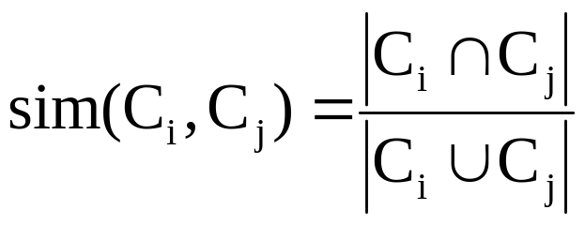
Column Similarity
View column as row-set (where it has 1’s)
Column Similarity (Jaccard measure)
Example
Finding correlated columns → finding similar columns
C_{i} C_{j}
0 1
1 0
1 1 sim(C_{i},C_{j}) = 2/5 = 0.4
0 0
1 1
0 1

Slide 31
Identifying Similar Columns?
Question – finding candidate pairs in small memory
Signature Idea
  Hash columns C_{i} to small signature sig(C_{i})
  Set of sig(C_{i}) fits in memory
  sim(C_{i},C_{j}) approximated by sim(sig(C_{i}),sig(C_{j}))
Naïve Approach
  Sample P rows uniformly at random
  Define sig(C_{i}) as P bits of C_{i} in sample
  Problem
    sparsity → would miss interesting part of columns
    sample would get only 0’s in columns

Slide 32
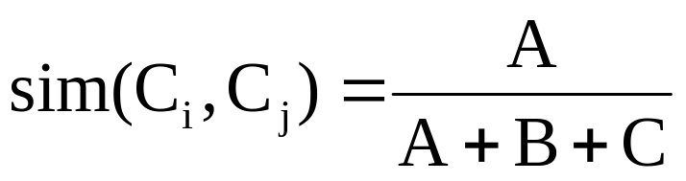
Key Observation
For columns C_{i}, C_{j}, four types of rows
  C_{i} C_{j}
  A 1 1
  B 1 0
  C 0 1
  D 0 0
Overload notation: A = # of rows of type A
Claim

Slide 33
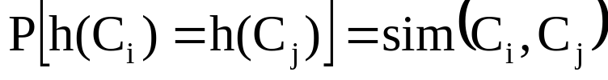
Min Hashing
Randomly permute rows
Hash h(C_{i}) = index of first row with 1 in column C_{i}
Suprising Property
Why?
  Both are A/(A+B+C)
  Look down columns C_{i}, C_{j} until first non-Type-D row
  h(C_{i}) = h(C_{j}) ←→ type A row

Slide 34
Min-Hash Signatures
Pick – P random row permutations
MinHash Signature
  sig(C) = list of P indexes of first rows with 1 in column C
Similarity of signatures
  Fact: sim(sig(C_{i}),sig(C_{j})) = fraction of permutations where MinHash values agree
  Observe E[sim(sig(C_{i}),sig(C_{j}))] = sim(C_{i},C_{j})

Slide 35
Example
Signatures
S₁ S₂ S₃
Perm 1 = (12345) 1 2 1
Perm 2 = (54321) 4 5 4
Perm 3 = (34512) 3 5 4
C₁ C₂ C₃
R₁ 1 0 1
R₂ 0 1 1
R₃ 1 0 0
R₄ 1 0 1
R₅ 0 1 0
Similarities
1-2 1-3 2-3
Col-Col 0.00 0.50 0.25
Sig-Sig 0.00 0.67 0.00

Slide 36
Implementation Trick
Permuting rows even once is prohibitive
Row Hashing
  Pick P hash functions h_{k}: {1,…,n}→{1,…,O(n²)} [Fingerprint]
  Ordering under h_{k} gives random row permutation
One-pass Implementation
  For each C_{i} and h_{k}, keep “slot” for min-hash value
  Initialize all slot(C_{i},h_{k}) to infinity
  Scan rows in arbitrary order looking for 1’s
    Suppose row R_{j} has 1 in column C_{i}
    For each h_{k},
      if h_{k}(j) < slot(C_{i},h_{k}), then slot(C_{i},h_{k}) ← h_{k}(j)

Slide 37
Example
C₁ slots C₂ slots
C₁ C₂
R₁ 1 0
R₂ 0 1
R₃ 1 1
R₄ 1 0
R₅ 0 1
h(1) = 1 1 -
g(1) = 3 3 -
h(2) = 2 1 2
g(2) = 0 3 0
h(3) = 3 1 2
g(3) = 2 2 0
h(4) = 4 1 2
g(4) = 4 2 0
h(x) = x mod 5
g(x) = 2x+1 mod 5
h(5) = 0 1 0
g(5) = 1 2 0

Slide 38
Comparing Signatures
Signature Matrix S
  Rows = Hash Functions
  Columns = Columns
  Entries = Signatures
Compute – Pair-wise similarity of signature columns
Problem
  MinHash fits column signatures in memory
  But comparing signature-pairs takes too much time
Technique to limit candidate pairs?
  A-Priori does not work
  Locality Sensitive Hashing (LSH)

Slide 39
Locality-Sensitive Hashing
Partition signature matrix S
  b bands of r rows (br=P)
Band Hash H_{q}: {r-columns}→{1,…,k}
Candidate pairs – hash to same bucket at least once
Tune – catch most similar pairs, few nonsimilar pairs
Bands
H₃

Slide 40
Example
Suppose m=100,000 columns
Signature Matrix
  Signatures from P=100 hashes
  Space – total 40Mb
Number of column pairs – total 5,000,000,000
Band-Hash Tables
  Choose b=20 bands of r=5 rows each
  Space – total 8Mb

Slide 41
Band-Hash Analysis
Suppose sim(C_{i},C_{j}) = 0.8
  P[C_{i},C_{j} identical in one band]=(0.8)^5 = 0.33
  P[C_{i},C_{j} distinct in all bands]=(1-0.33)^20 = 0.00035
  Miss 1/3000 of 80%-similar column pairs
Suppose sim(C_{i},C_{j}) = 0.4
  P[C_{i},C_{j} identical in one band] = (0.4)^5 = 0.01
  P[C_{i},C_{j} identical in >0 bands] < 0.01*20 = 0.2
  Low probability that nonidentical columns in band collide
  False positives much lower for similarities << 40%
Overall – Band-Hash collisions measure similarity
Formal Analysis – later in near-neighbor lectures

Slide 42
LSH Summary
Pass 1 – compute singature matrix
Band-Hash – to generate candidate pairs
Pass 2 – check similarity of candidate pairs
LSH Tuning – find almost all pairs with similar signatures, but eliminate most pairs with dissimilar signatures

Slide 43
Densifying – Amplification of 1’s
Dense matrices simpler – sample of P rows serves as good signature
Hamming LSH
  construct series of matrices
  repeatedly halve rows – ORing adjacent row-pairs
  thereby, increase density
Each Matrix
  select candidate pairs
  between 30–60% 1’s
  similar in selected rows

Slide 44
Example
0
0
1
1
0
0
1
0
0
1
0
1
1
1
1

Slide 45
Using Hamming LSH
Constructing matrices
  n rows → log₂n matrices
  total work = twice that of reading original matrix
Using standard LSH
  identify similar columns in each matrix
  restrict to columns of medium density

Slide 46
Summary
Finding frequent pairs
  A-priori → PCY (hashing) → multistage
Finding all frequent itemsets
  Sampling → SON → Toivonen
Finding similar pairs
  MinHash+LSH, Hamming LSH
Further Work
  Scope for improved algorithms
  Exploit frequency counting ideas from earlier lectures
  More complex rules (e.g. non-monotonic, negations)
  Extend similar pairs to k-sets
  Statistical validity issues

Slide 47
References
Mining Associations between Sets of Items in Massive Databases, R. Agrawal, T. Imielinski, and A. Swami. SIGMOD 1993.
Fast Algorithms for Mining Association Rules, R. Agrawal and R. Srikant. VLDB 1994.
An Effective Hash-Based Algorithm for Mining Association Rules, J. S. Park, M.-S. Chen, and P. S. Yu. SIGMOD 1995.
An Efficient Algorithm for Mining Association Rules in Large Databases , A. Savasere, E. Omiecinski, and S. Navathe. The VLDB Journal 1995.
Sampling Large Databases for Association Rules, H. Toivonen. VLDB 1996.
Dynamic Itemset Counting and Implication Rules for Market Basket Data, S. Brin, R. Motwani, S. Tsur, and J.D. Ullman. SIGMOD 1997.
Query Flocks: A Generalization of Association-Rule Mining, D. Tsur, J.D. Ullman, S. Abiteboul, C. Clifton, R. Motwani, S. Nestorov and A. Rosenthal. SIGMOD 1998.
Finding Interesting Associations without Support Pruning, E. Cohen, M. Datar, S. Fujiwara, A. Gionis, P. Indyk, R. Motwani, J.D. Ullman, and C. Yang. ICDE 2000.
Dynamic Miss-Counting Algorithms: Finding Implication and Similarity Rules with Confidence Pruning, S. Fujiwara, R. Motwani, and J.D. Ullman. ICDE 2000.

